Slide 1
Wandering in the Woods
Sandeep Perikala
Naveen Madupoju
Arshiya Nooreen
Praneeth Somisetty
Khaja Ahmed Hussain Syed

Slide 2
Introduction
Wandering in the woods is a game which is a rather straightforward visualization intended to explain the fundamental concept to kids in grades K-2 (and hopefully to amuse kids); kids would select and watch what happens.
We intend for levels 3 to 5 kids to deal with individual information generating activities, or "little data," in a somewhat more challenging form in which they decide things, view information, and face extra challenges.
There will be a more complicated edition for grades 6 to 8, where children participate with small and large data, charts are produced, and learners decide things that mostly transform the data.

Slide 3
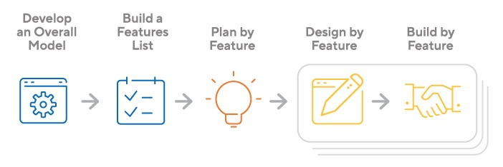
Process Model
The FDD method is structured in five stages, each of which is based on individual "feature" projects. This is the project lifecycle:
Create a comprehensive plan
Create a list of functionalities
Create a strategy based on features
Feature-based design
Systematical feature-based design
For the development of game, the software development team will use Feature-Driven Development (FDD) process model.
In Agile, FDD supports regular status monitoring to focus attention on development and evaluate performance.
FDD enables teams to rapidly detect flaws and implement fixes with frequent updates to the project.
In addition, information and significant outcomes may be made available to customers at any time. However, features in the FDD context may not always correspond to the conventionally known notion of a product's characteristics.

Slide 4
Use Case
We have the following use cases for our application:
Use Case 1: Start Game
Use Case 2: End Game
Use Case 3: Wander
Use Case 4: Setup Size of Grid
Use Case 5: Run Experiments
Use Case 6: Exploring Different Protocols
Use Case 7: Display Statistics
Use Case 8: Play Music

Slide 5
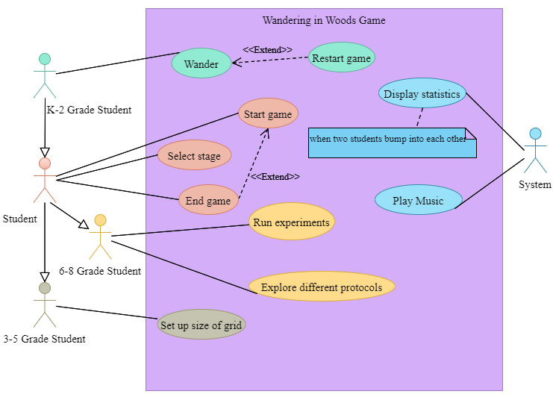
Use Case Diagram

Slide 6
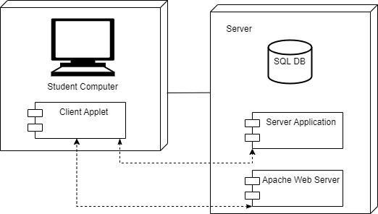
Deployment Diagram

Slide 7
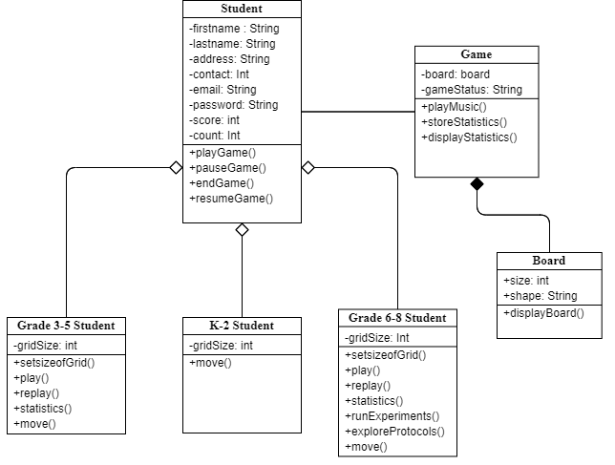
Class Diagram

Slide 8
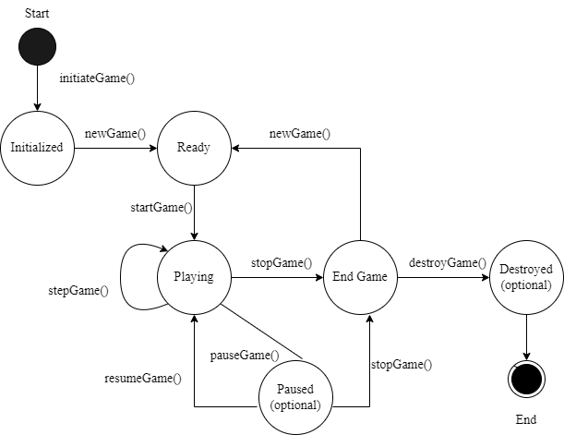
State Diagram

Slide 9
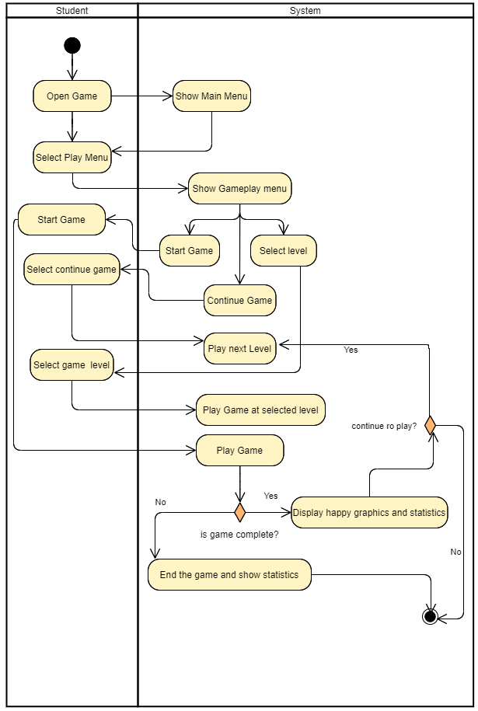
4.5 Activity Diagram

Slide 10
Customer Journey Map
A customer journey map is a basic concept: it's a graphic that shows the many interactions a client has with our business, whether they're purchasing something from us online, at a store, or using one of our services.
The goal of student is to enhance computational thinking and basic concepts of math, and computer science.
The game will be designed as a s simulation to provide the students an opportunity to select the level depending upon the grade and play the game while system will present different challenges.
We must remember that when the prototype undergoes additional testing and development, it may reveal previously unknown dangers to the client, which may need revisions to this document.

Slide 11
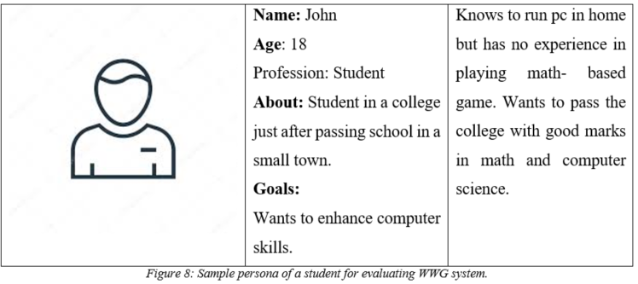
Persona

Slide 12
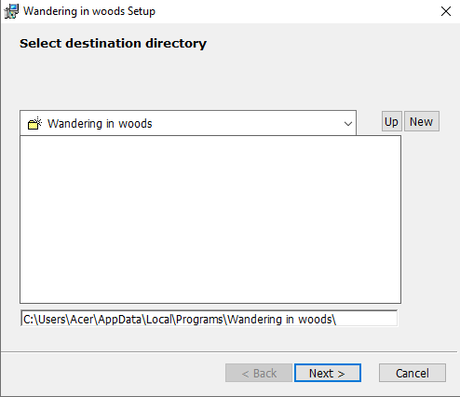
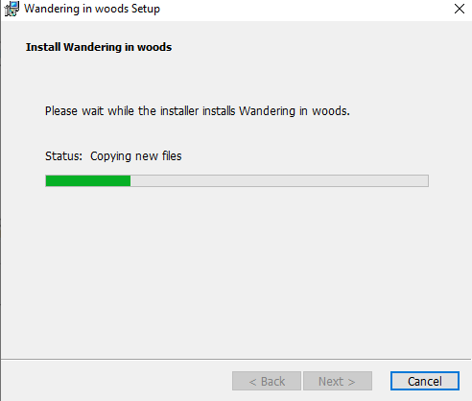
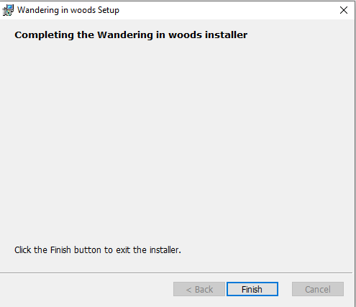
UI Mockup
Installation:
Step 1: Click on “Wandering in woods-win64”
Step 2: Click next
Step 3: After completing the installation Click Finish

Slide 13
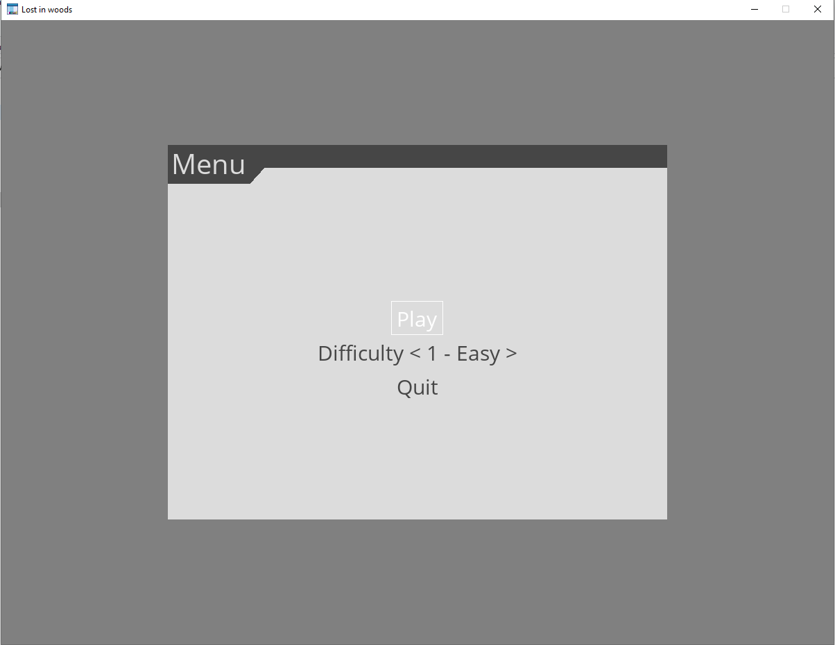
Continued
GUI Layout of Application

Slide 14
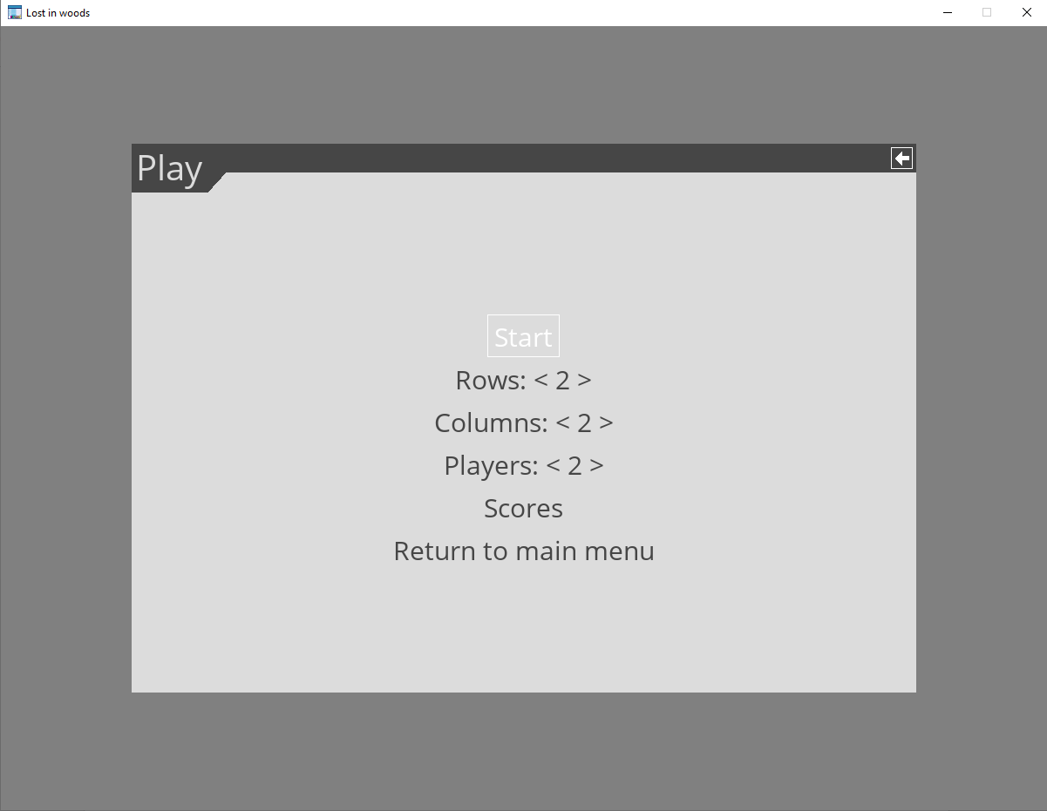
Continued…
Next

Slide 15
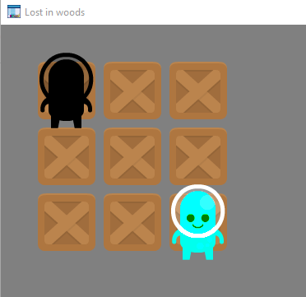
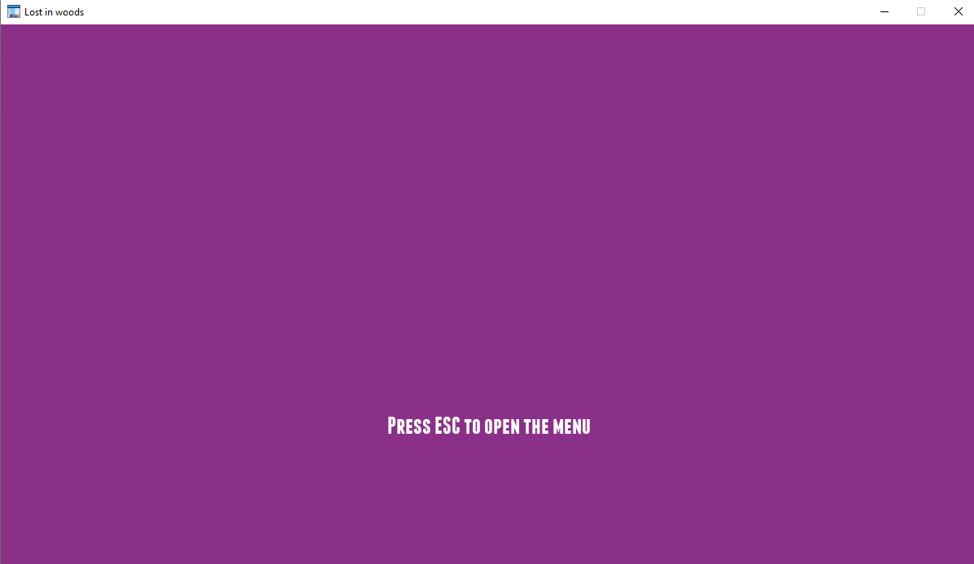
Continued …
Next

Slide 16
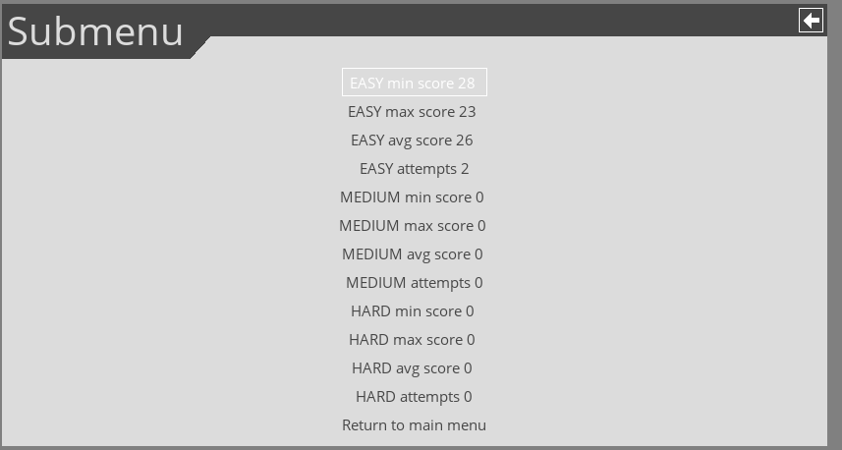
Continued …
Stats

